Slide 1
CCS3101
OBJECT-ORIENTED PROGRAMMING Topic 2 Object-Oriented Modeling

Slide 2
Learning Objectives
At the end of this chapter, you will be able to:
Explain the process of object-oriented software development (A3)
Analyze the type of relationship: association, aggregation, composition or inheritance (C4)

Slide 3
Motivations
You see the advantages of object-oriented programming from the preceding chapter. This chapter will demonstrate how to solve problems using the object-oriented paradigm.

Slide 4
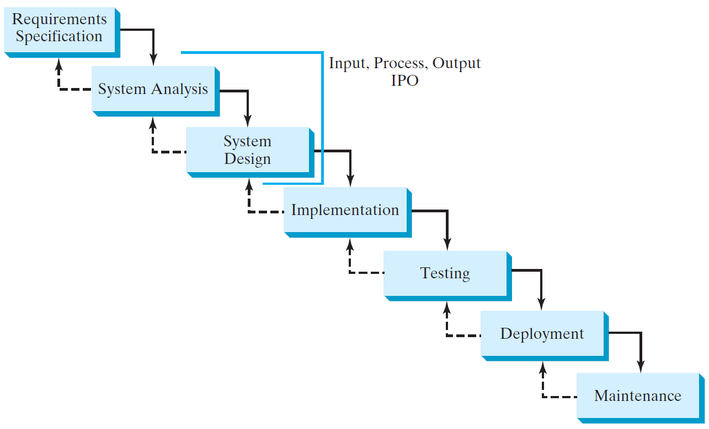
Software Development Process

Slide 5
Requirement Specification
A formal process that seeks to understand the problem and document in detail what the software system needs to do. This phase involves close interaction between users and designers.
Most of the examples in this book are simple, and their requirements are clearly stated. In the real world, however, problems are not well defined. You need to study a problem carefully to identify its requirements.

Slide 6
System Analysis
Seeks to analyze the business process in terms of data flow, and to identify the system’s input and output.
Part of the analysis entails modeling the system’s behavior. The model is intended to capture the essential elements of the system and to define services to the system.

Slide 7
System Design
The process of designing the system’s components.
This phase involves the use of many levels of abstraction to decompose the problem into manageable components, identify classes and interfaces, and establish relationships among the classes and interfaces.

Slide 8
Implementation
The process of translating the system design into programs. Separate programs are written for each component and put to work together.
This phase requires the use of a programming language like Java. The implementation involves coding, testing, and debugging.

Slide 9
Testing
Ensures that the code meets the requirements specification and weeds out bugs.
An independent team of software engineers not involved in the design and implementation of the project usually conducts such testing.

Slide 10
Deployment
Deployment makes the project available for use.
For a Java program, this means installing it on a desktop or on the Web.

Slide 11
Maintenance
Maintenance is concerned with changing and improving the product.
A software product must continue to perform and improve in a changing environment. This requires periodic upgrades of the product to fix newly discovered bugs and incorporate changes.

Slide 12
Class Abstraction and Encapsulation
Class abstraction means to separate class implementation from the use of the class. The creator of the class provides a description of the class and let the user know how the class can be used. The user of the class does not need to know how the class is implemented. The detail of implementation is encapsulated and hidden from the user.

Slide 13
Designing the Loan Class
Loan
TestLoanClass
Run

Slide 14
Object-Oriented Thinking
Chapters 1-8 introduced fundamental programming techniques for problem solving using loops, methods, and arrays. The studies of these techniques lay a solid foundation for object-oriented programming. Classes provide more flexibility and modularity for building reusable software. This section (Chapter 10) improves the solution for a problem introduced in Chapter 2 using the object-oriented approach. From the improvements, you will gain the insight on the differences between the procedural programming and object-oriented programming and see the benefits of developing reusable code using objects and classes.

Slide 15
The BMI Class
BMI
UseBMIClass
Run

Slide 16
Class Relationships
Association
Aggregation
Composition
Inheritance (Chapter 11)

Slide 17
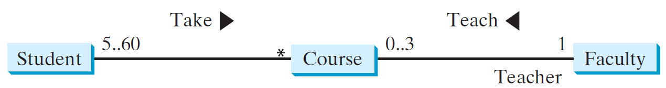
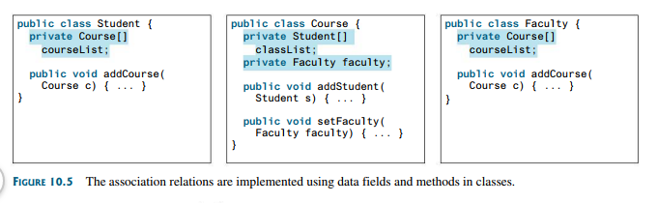
Association
Association represents a general binary relationship that describes an activity between two classes.
An association is usually represented as a data field and methods in the class.

Slide 18
Aggregation and Composition
Aggregation is a special form of association, which represents an ownership relationship between two classes.
Aggregation models the has-a relationship.
The owner object is called aggregating object, and its class an aggregating class.
The subject object is called an aggregated object and its class an aggregated class.
Aggregation between two objects known as composition if the existence of the aggregated object is dependent on the aggregating object.
If Object B is contained within Object A, then Object A is responsible for the creation and destruction of Object B. Unlike aggregation, Object B cannot exist without Object A.

Slide 19
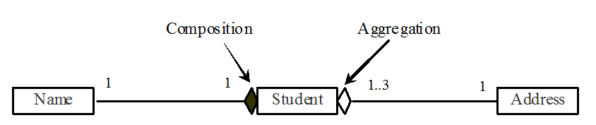
Aggregation and Composition, cont.
In UML, filled diamond is attached to an aggregating class (Student) to denote the composition relationship with an aggregated class (Name).
Empty diamond is attached to aggregating class (Student) to denote the aggregation relationship with an aggregated class (Address)

Slide 20
Class Representation
An aggregation relationship is usually represented as a data field in the aggregating class. For example, the relationship in slide 19 can be represented as follows:

Slide 21
Aggregation or Composition
Since aggregation and composition relationships are represented using classes in similar ways, many texts don’t differentiate them and call both compositions.

Slide 22
Aggregation Between Same Class
Aggregation may exist between objects of the same class. For example, a person may have a supervisor.
public class Person {
// The type for the data is the class itself
private Person supervisor;
...
}

Slide 23
Aggregation Between Same Class
What happens if a person has several supervisors?

Slide 24
Example: The Course Class
Course
TestCourse
Run

Slide 25
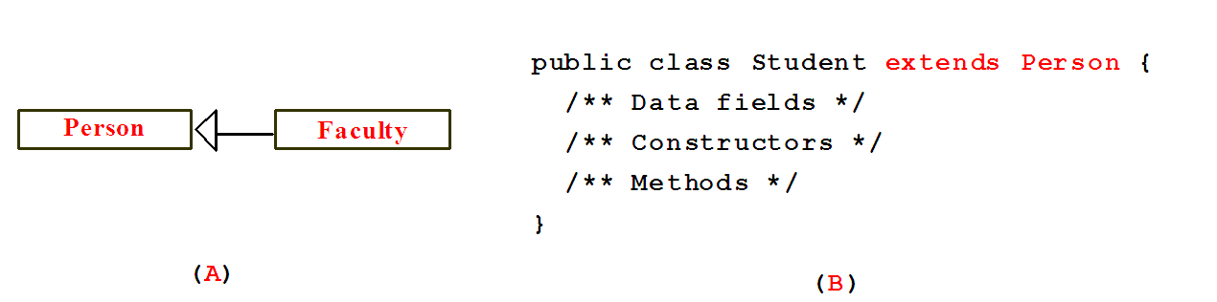
Inheritance
Inheritance models the is-a relationship between two classes.

Slide 26
Weak Inheritance Relationship
A weak is-a relationship can be represented using interfaces.
For example, the weak is-a relationship “students are comparable based on their grades” can be represented by implementing the Comparable interface, as follows:

Slide 27
Class Design
1. Identify classes for the system.
2. Describe attributes and methods in each class.
3. Establish relationships among classes.
4. Create classes.

Slide 28
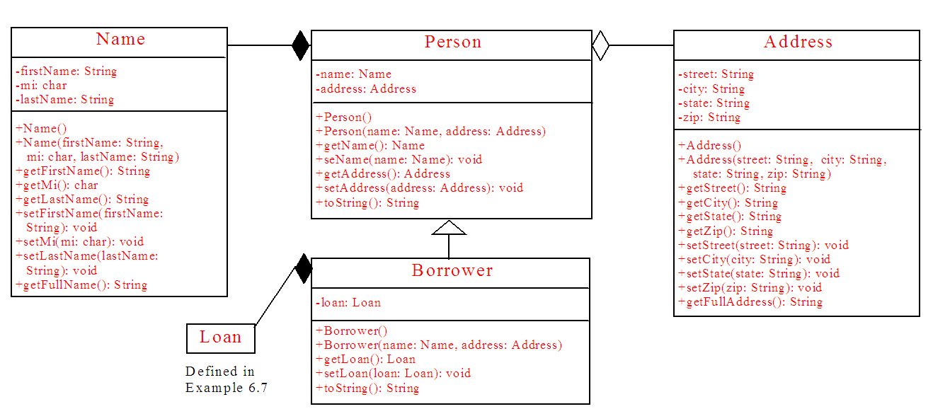
Example 1: Borrowing Loans
Name
Loan
Person
Borrower
Address

Slide 29
Example 1: Borrowing Loans, cont.
The following is a test program that uses the classes Name, Person, Address, Borrower, and Loan.

Slide 30
public class Name{
private String firstName;
private char mi;
private String lastName;
/** Construct a name with firstName, mi, and lastName */
public Name(String firstName, char mi, String lastName) {
this.firstName = firstName;
this.mi = mi;
this.lastName = lastName;
}
/** Return firstName */
public String getFirstName() {
return firstName;
}
/** Return middle name initial */
public char getMi() {
return mi;
}

Slide 31
/** Return lastName */
public String getLastname() {
return lastName;
}
/** Obtain full name */
public String getFullName() {
return firstName + ' ' + mi + ' ' + lastName;
}
}

Slide 32
public class Person{
private Name name;
private Address address;
/** Construct a person with default properties */
public Person() {
this(new Name("Jill", 'S', "Barr"),
new Address("100 Main", "Savannah", "GA", "31411"));
}
/** Construct a person with specified name and address */
public Person(Name name, Address address) {
this.name = name;
this.address = address;
}
/** Return name */
public Name getName() {
return name;
}

Slide 33
/** Set a new name */
public void setName(Name name) {
this.name = name;
}
/** Return address */
public Address getAddress() {
return address;
}
/** Set a new address */
public void setAddress(Address address) {
this.address = address;
}
/** Override the toString method */
public String toString() {
return '\n' + name.getFullName() + '\n' +
address.getFullAddress() + '\n';
}
}

Slide 34
public class Address {
private String street;
private String city;
private String state;
private String zip;
/** Create an address with street, city, state, and zip */
public Address(String street, String city,
String state, String zip) {
this.street = street;
this.city = city;
this.state = state;
this.zip = zip;
}
/** Return street */
public String getStreet() {
return street;
}

Slide 35
/** Return city */
public String getCity() {
return city;
}
/** Return state */
public String getState() {
return state;
}
/** Return zip */
public String getZip() {
return zip;
}
/** Get full address */
public String getFullAddress() {
return street + '\n' + city + ", " + state + ' ' + zip + '\n';
}
}

Slide 36
public class Borrower extends Person {
private Loan loan;
/** Construct a borrower with default properties */
public Borrower() {
super();
}
/** Create a borrower with specified name and address */
public Borrower(Name name, Address address) {
super(name, address);
}
/** Return loan */
public Loan getLoan() {
return loan;
}

Slide 37
/** Set a new loan */
public void setLoan(Loan loan) {
this.loan = loan;
}
/** String representation for borrower */
public String toString() {
return super.toString() +
"Monthly payment is " + loan.getMonthlyPayment() + '\n' +
"Total payment is " + loan.getTotalPayment();
}
}

Slide 38
public class Loan {
private double annualInterestRate;
private int numberOfYears;
private double loanAmount;
private java.util.Date loanDate;
/** Default constructor */
public Loan() {
this(7.5, 30, 100000);
}
public Loan(double annualInterestRate, int numberOfYears,
double loanAmount) {
this.annualInterestRate = annualInterestRate;
this.numberOfYears = numberOfYears;
this.loanAmount = loanAmount;
loanDate = new java.util.Date();
}
}

Slide 39
public static void main(String[] args) {
// Create a name
Name name = new Name("John", 'D', "Smith");
// Create an address
Address address = new Address("100 Main Street", "Savannah", "GA", "31419");
// Create a loan
Loan loan = new Loan(5.5, 15, 250000);
// Create a borrower
Borrower borrower = new Borrower(name, address);
borrower.setLoan(loan);
// Display loan information
JOptionPane.showMessageDialog(null, borrower.toString());
}
}

Slide 40
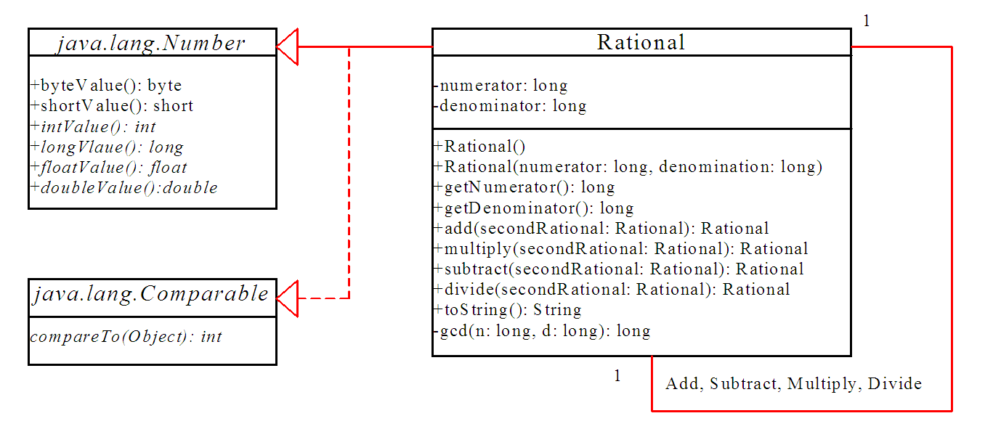
Example 2: The Rational Class

Slide 41
Class Design Guidelines
Designing a Single Class.
Using Modifiers public, private and static
Using Inheritance or Composition

Slide 42
Designing a Class
A single entity with too many responsibilities should be broken into several classes to separate responsibilities.
The String class, StringBuffer class, and StringTokenizer class all deal with strings, for example, but have different responsibilities.
Classes are usually designed for use by many different customers.
To make a class useful in a wide range of applications, the class should provide a variety of ways for customization through properties and methods.
A class should describe a single entity or a set of similar operations.
Classes are designed for reuse.
Users can incorporate classes in many different combinations, orders, and environments.

Slide 43
Designing a Class, cont.
Therefore, you should design
a class that imposes no restrictions on what or when the user can do with it,
design the properties to ensure that the user can set properties in any order, with any combination of values, and
design methods to function independently of their order of occurrence.
Provide a public no-arg constructor and override the equals method and the toString method defined in the Object class whenever possible.

Slide 44
Designing a Class, cont.
Follow standard Java programming style and naming conventions.
Choose informative names for classes, data fields, and methods.
Always place the data declaration before the constructor, and place constructors before methods.
Always provide a constructor and initialize variables to avoid programming errors.

Slide 45
Using Visibility Modifiers and Static
Each class can present two contracts (only one explained here):
for the users of the class
Make the fields private and accessor methods public if they are intended for the users of the class.
A class should use the private modifier to hide its data from direct access by clients.
You can use get methods and set methods to provide users with access to the private data, but only to private data you want the user to see or to modify.
A class should also hide methods not intended for client use.
The gcd method in the Rational class in Example 10.2, “The Rational Class,” is private, for example, because it is only for internal use within the class.

Slide 46
Using the static Modifier
A property that is shared by all the instances of the class should be declared as a static property.

Slide 47
Using Inheritance or Composition
In general, the difference between inheritance and composition is the difference between the is-a relationship and the has-a relationship.
For example:
An apple is fruit; thus, you would use inheritance to model the relationship between the classes Apple and Fruit.
A person has a name; thus, you would use composition to model the relationship between the classes Person and Name.
Sometimes, the choice between inheritance and composition is not obvious.

Slide 48
The Java API
The Java API (Application Program Interface, Application Programming Interface, or Application Programmer interface) consists of numerous classes and interfaces grouped into more than a dozen of packages.
You have used classes and interfaces in the java.lang, and java.util packages.

Slide 49
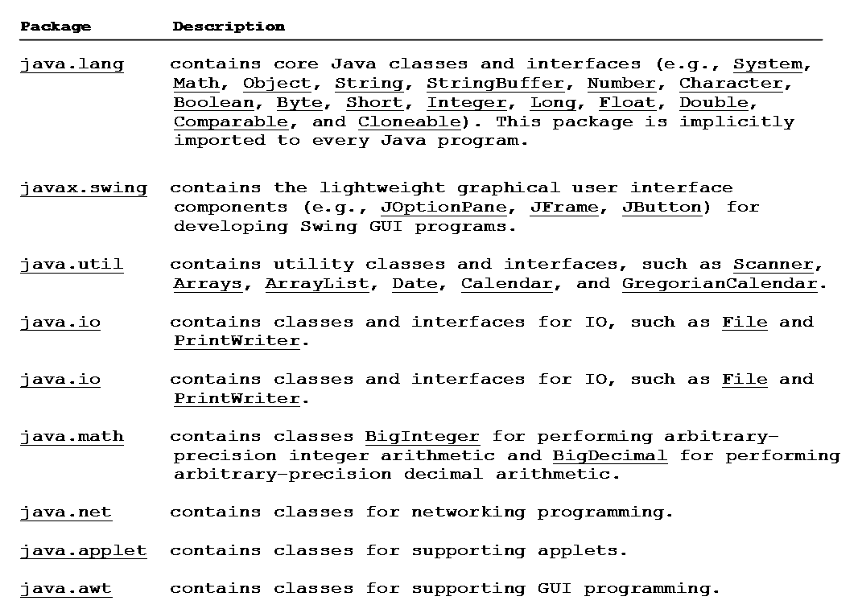

Slide 50
Summary
Software Development Process
Relationships (association / aggregation / composition and inheritance)
Class design

Slide 51
End of Chapter 2

